Slide 1



Kali Linux – Security tools
SadhasivasubramanianH

Slide 2


AGENDA
Why Kali Linux tools?
Testing phases
Reconnaissance tools
Scanning and enumeration tools
Exploitation tools
Bonus tool !

Slide 3

Why KALI LINUX TOOLS
Penetration Testing: Simulating attacks to identify vulnerabilities.
Digital Forensics: Analyzing digital evidence in cybercrime investigations.
Security Research: Understanding new threats and vulnerabilities.
Network Security: Monitoring and protecting network infrastructure.
Education and Training: Teaching cybersecurity concepts and practices.

Slide 4
Testing PHASES
Reconnaissance
Scanning & Enumeration
Vulnerability Analysis
Exploitation
Reporting

Slide 5

Reconnaissance

Slide 6

Reconnaissance
Nmap - network discovery and scanning
Recon-ng - A web reconnaissance framework with modules to collect information from various sources.
Maltego - For visualizing and linking information

Slide 7
NMAP
Nmap (Network Mapper) is a powerful, open-source network scanning tool used in various stages of penetration testing and network security auditing. It is designed to discover hosts and services on a computer network, thus creating a "map" of the network.
  Host Discovery
  Port Scanning
  Service Version Detection
  Operating System Detection
  Scriptable Interaction with Targets
  Network Mapping
  Firewall and IDS/IPS Evasion
nmap -sn 192.168.1.0/24 # Host discovery
nmap -sS -p 1-65535 192.168.1.100 # Full port scan
nmap -sV 192.168.1.100 # Service version detection
nmap -O 192.168.1.100 # OS detection
nmap --traceroute 192.168.1.100 # Network mapping
nmap --script=vuln 192.168.1.100 # Vulnerability detection using NSE
nmap -v -A scanme.nmap.org # Enable OS detection, version detection, script scanning, and traceroute

Slide 8
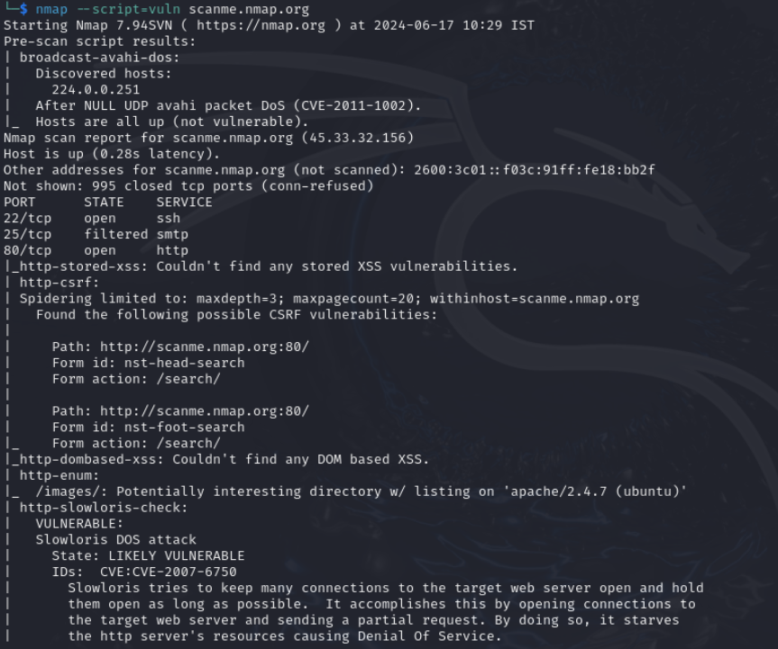
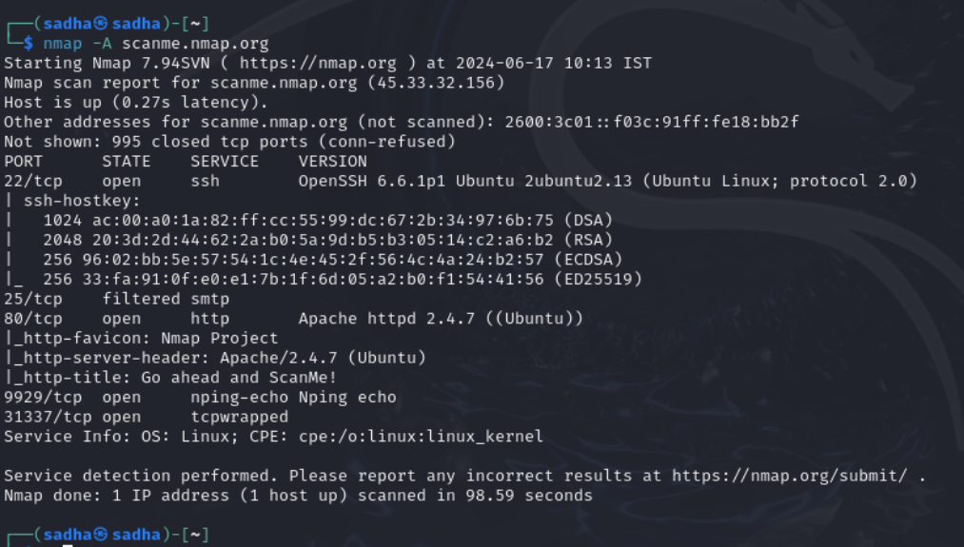
NMAP

Slide 9

Recon-ng
Recon-ng is a full-featured web reconnaissance framework written in Python.
Recon-ng is highly modular, enabling users to install, update, and execute different reconnaissance modules with ease.
Key Features:
  Modular Framework: Users can install and use specific modules as needed.
  Integrated Database: Stores collected data for easy access and correlation.
  Interactive Command Line Interface: Provides a user-friendly way to interact with the tool.
  API Keys Management: Easily manage API keys for external services used by various modules.

Slide 10
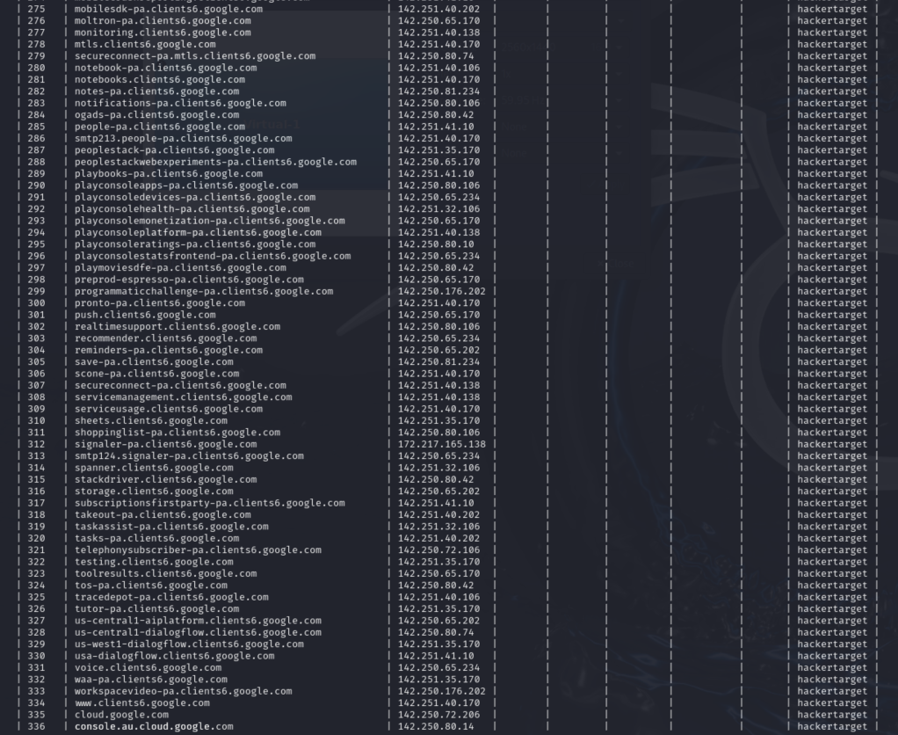
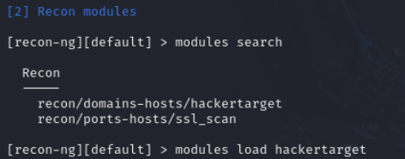
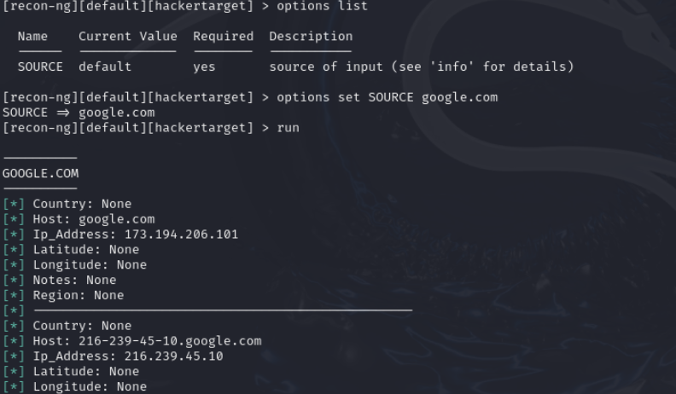
RECON-NG

Slide 11

Maltego
Maltego is a powerful open-source intelligence (OSINT) and forensics tool that helps in data gathering and link analysis. It is widely used for uncovering relationships among people, companies, domains, and other entities by transforming collected data into a graphical format.

Slide 12

Maltego
Maltego operates through a client-server model where the client (Maltego software) sends queries to various data sources, and the server processes these queries to retrieve and visualize information. It uses "transforms" to fetch related data from multiple sources, such as public records, social media, and domain registries, and represents this data in a graph.
  Transforms: Predefined operations that query external databases and APIs.
  Entities: Objects (like people, email addresses, domains) that transforms act upon.
  Graphs: Visual representations of entities and their relationships.

Slide 13
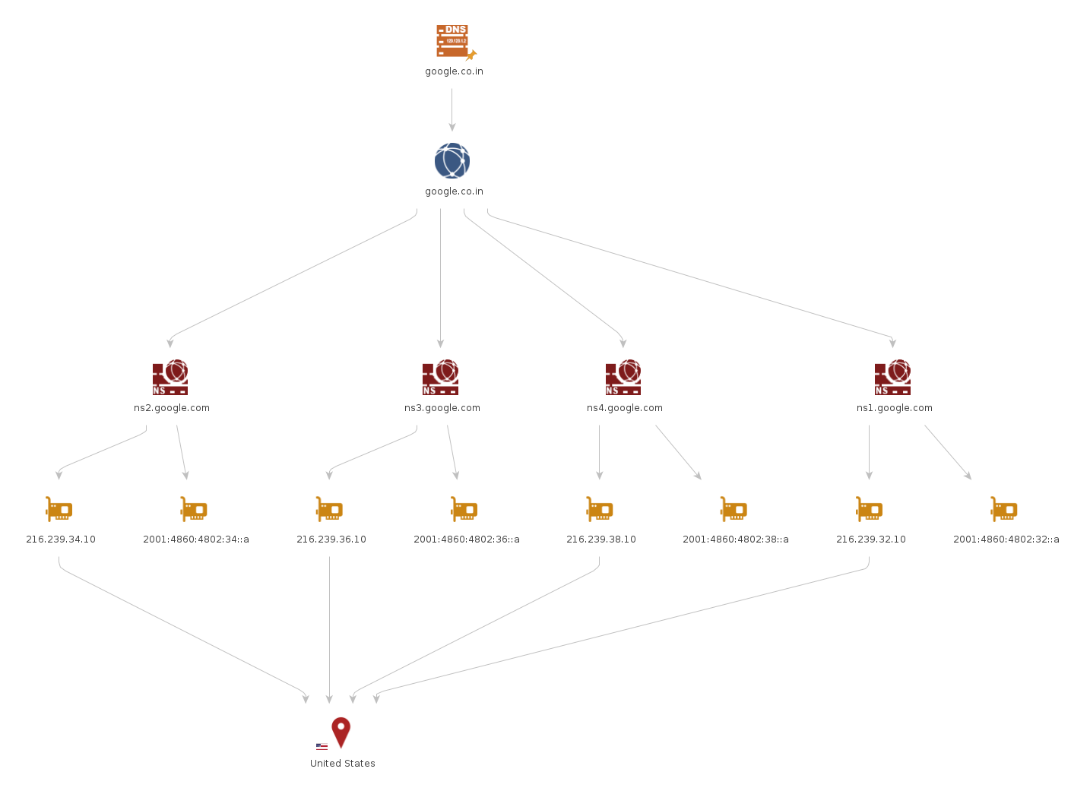
Maltego

Slide 14
Scanning & Enumeration

Slide 15

SCANNING & ENUMERATION
Nmap - scanning open ports and services.
OpenVAS - An open-source vulnerability scanner.
OWASP ZAP – An open-source web application security scanner.
Nikto - A web server scanner that detects vulnerabilities and misconfigurations.

Slide 16

Open VAS
OpenVAS (Open Vulnerability Assessment System) is an open-source framework used for vulnerability scanning and management. It is a comprehensive solution for detecting security issues in networked systems and applications, providing tools for both automated and manual testing.
Key Features:
  Extensive Vulnerability Database: Regularly updated with thousands of Network Vulnerability Tests (NVTs).
  Full Scan Automation: Capable of fully automating vulnerability scanning processes.
  Detailed Reporting: Generates detailed reports highlighting vulnerabilities, their severity, and recommended remediation steps.
  Customizable Scans: Users can configure scan parameters and create custom scan profiles.
  User Management: Supports multiple users and roles for collaborative security assessments.

Slide 17
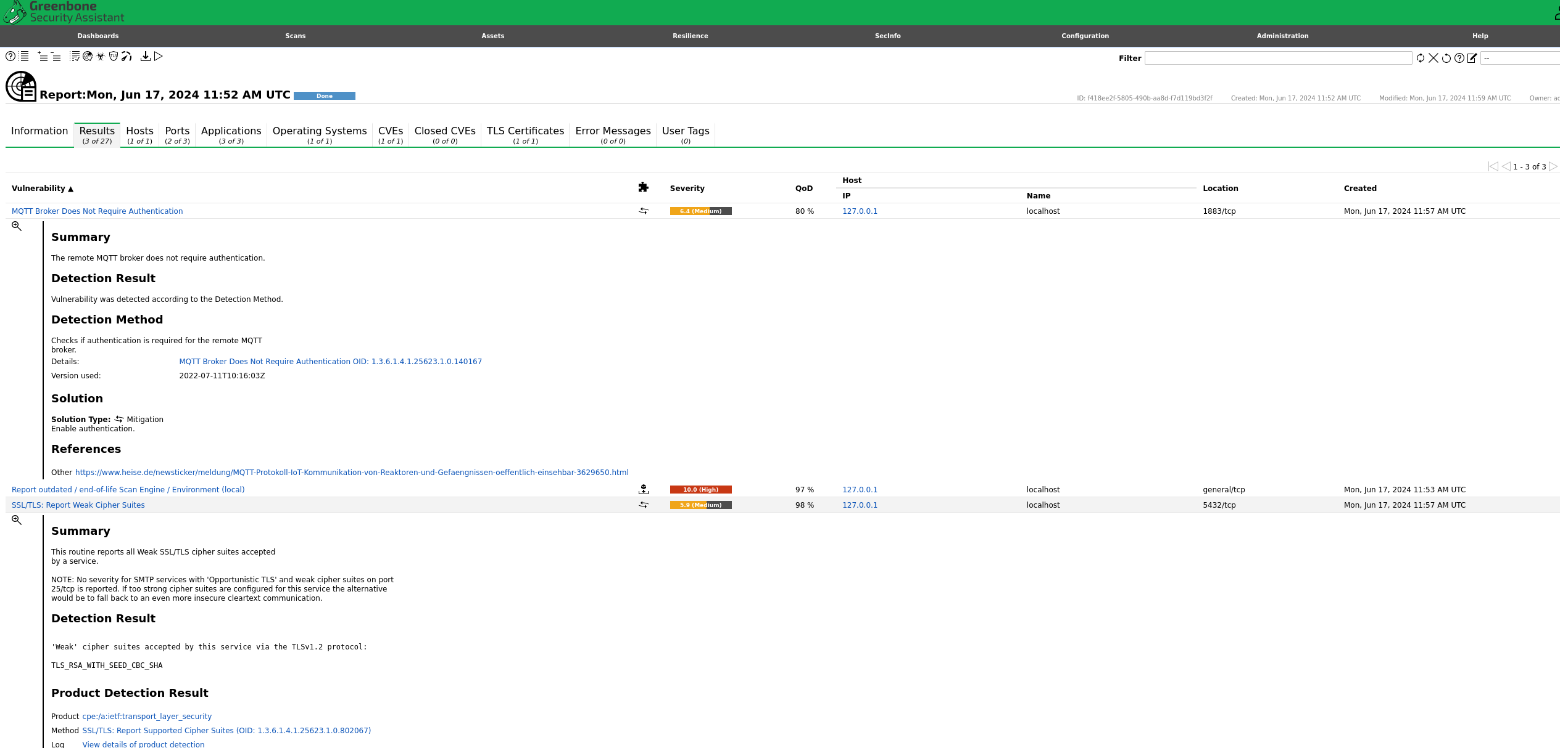
OPEN VAS

Slide 18
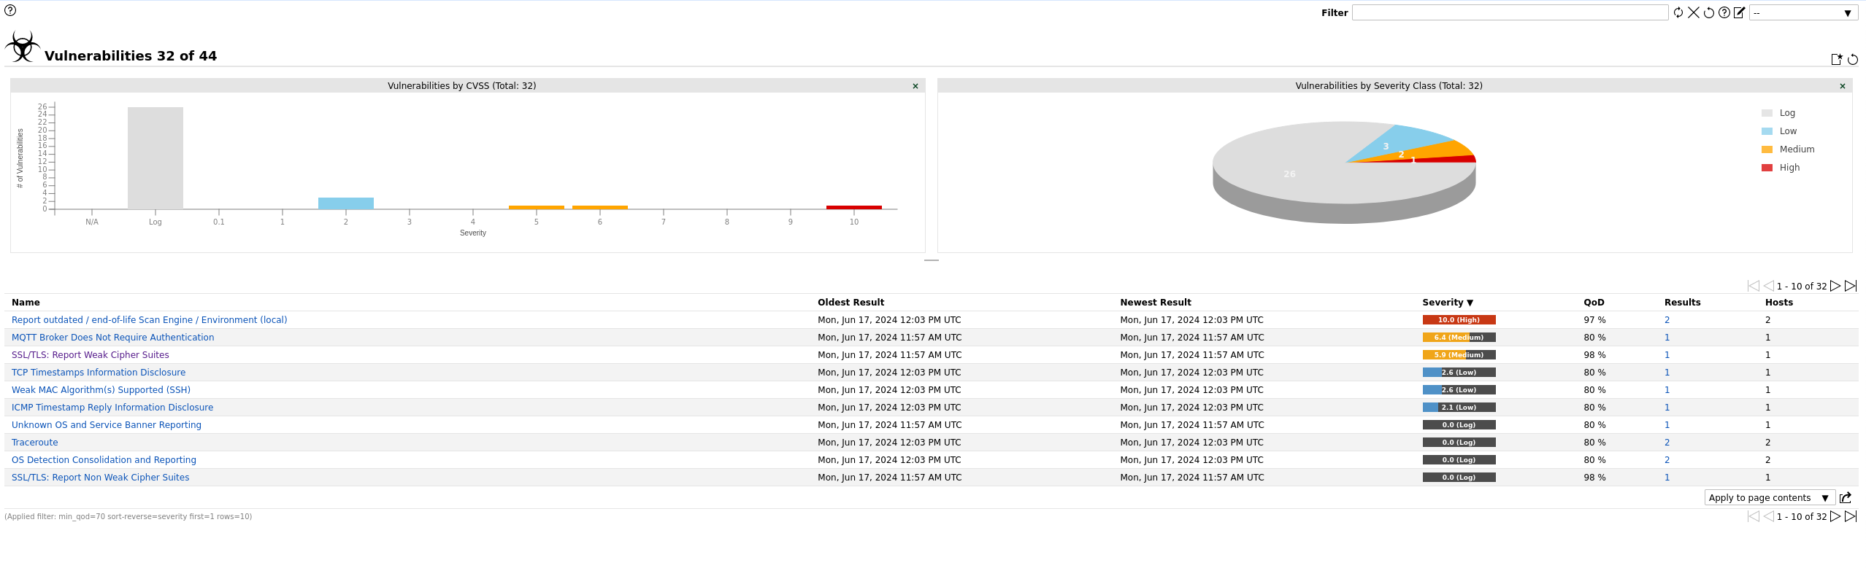
OPEN VAS

Slide 19

OWASP ZAP
OWASP ZAP (Zed Attack Proxy) is an open-source web application security scanner. It's widely used by security professionals and penetration testers for finding vulnerabilities in web applications. ZAP is designed to be used by people with a wide range of security experience and offers an easy-to-use interface, automated scanners, and various advanced tools for manual testing.
Key Features:
  Automated Scanning: Quickly find vulnerabilities in web applications.
  Manual Testing Tools: Includes tools for manual testing such as a proxy for inspecting and modifying requests.
  Active and Passive Scanning: Can perform both active attacks and passive analysis of web traffic.
  Extensibility: Supports plugins to add additional features.
  Report Generation: Generate reports in various formats to document findings.

Slide 20
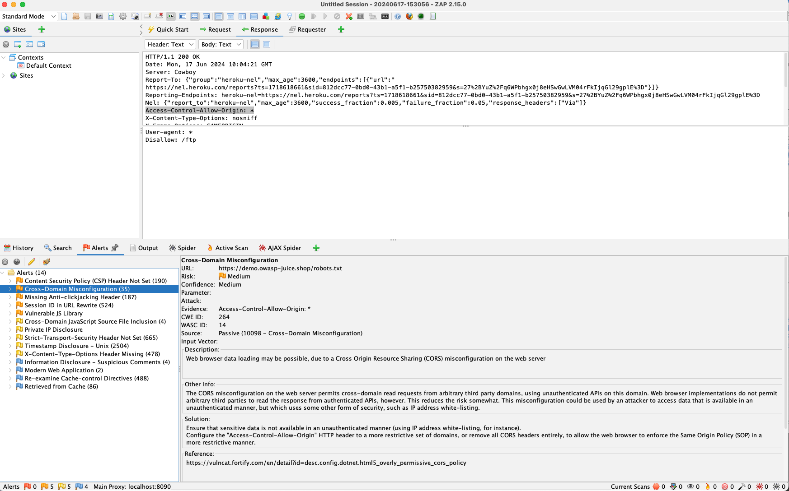
OWSAP ZAP

Slide 21

Nikto
Nikto is an open-source web server scanner designed to identify potential vulnerabilities and security issues in web servers. It performs comprehensive tests against web servers for multiple types of vulnerabilities, including outdated software versions, dangerous files or scripts, and configuration issues.
Key Features:
  Extensive Test Coverage: Scans for over 6,700 potentially dangerous files/programs.
  Vulnerability Identification: Detects over 1,250 versions of servers and identifies potential vulnerabilities.
  Cross-Platform Support: Works on any system with Perl installed.
  Customizable: Supports plugins and user-defined tests.
  Multiple Reporting Formats: Can output results in various formats, including plain text, HTML, XML, and CSV.
  SSL Support: Can test HTTPS web servers.

Slide 22
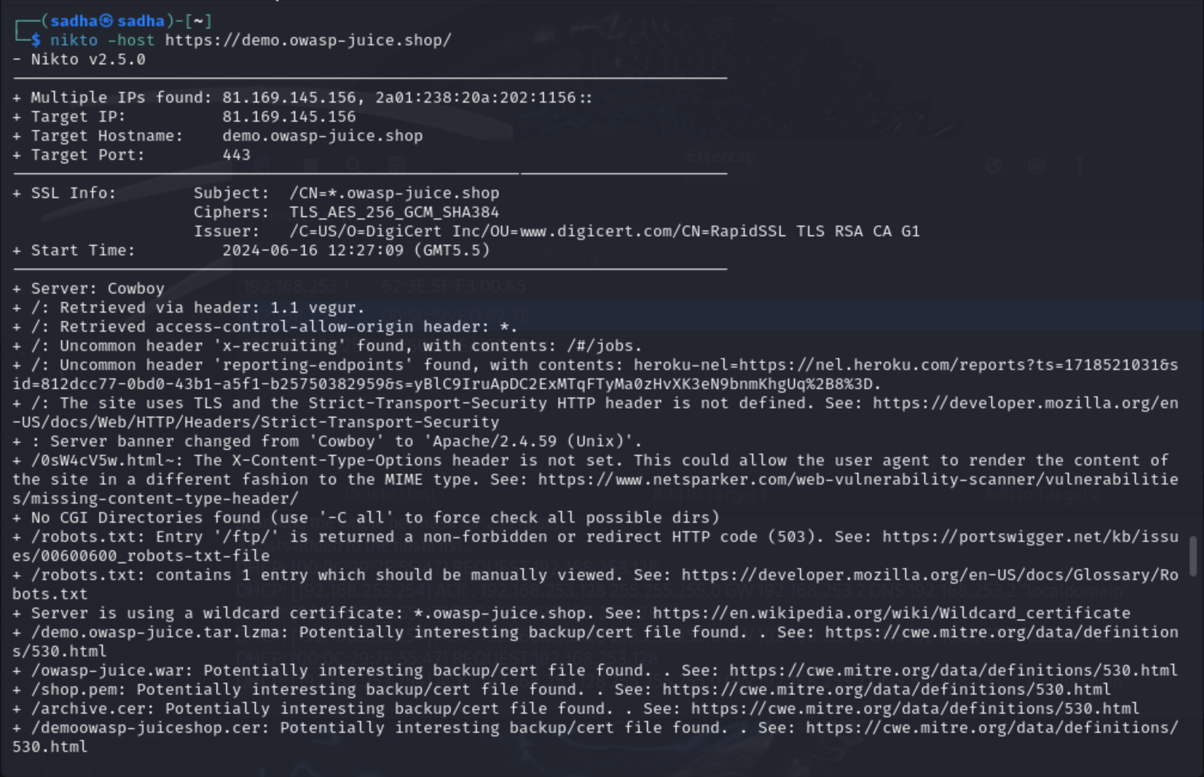
Nikto

Slide 23
Exploitation

Slide 24

Exploitation
Metasploit Framework - A powerful tool for developing and executing exploit code against a remote target.
SQLmap - An automatic SQL injection and database takeover tool.
Hydra/John the Ripper - For brute-force attacks on passwords.
Burp Suite - For web application security testing.

Slide 25

Metasploit Framework
The Metasploit Framework is one of the most popular tools for penetration testing, ethical hacking, and network security assessments. Developed by Rapid7, Metasploit is an open-source framework that provides tools for discovering, exploiting, and validating vulnerabilities in various systems. It supports a wide range of exploits, payloads, and auxiliary modules, making it an essential tool for security professionals.
Key Features:
  Modular Architecture: Supports a vast library of exploits, payloads, and auxiliary modules.
  Extensive Exploit Database: Includes exploits for numerous vulnerabilities.
  Payload Options: Provides various payloads for different attack vectors.
  Post-Exploitation Modules: Offers tools for gathering information, maintaining access, and further exploitation after initial access.
  Community and Commercial Editions: The open-source community edition is free, while the commercial edition offers additional features and support.
  Integration with Other Tools: Can be integrated with other security tools like Nmap, Nexpose, and more.

Slide 26
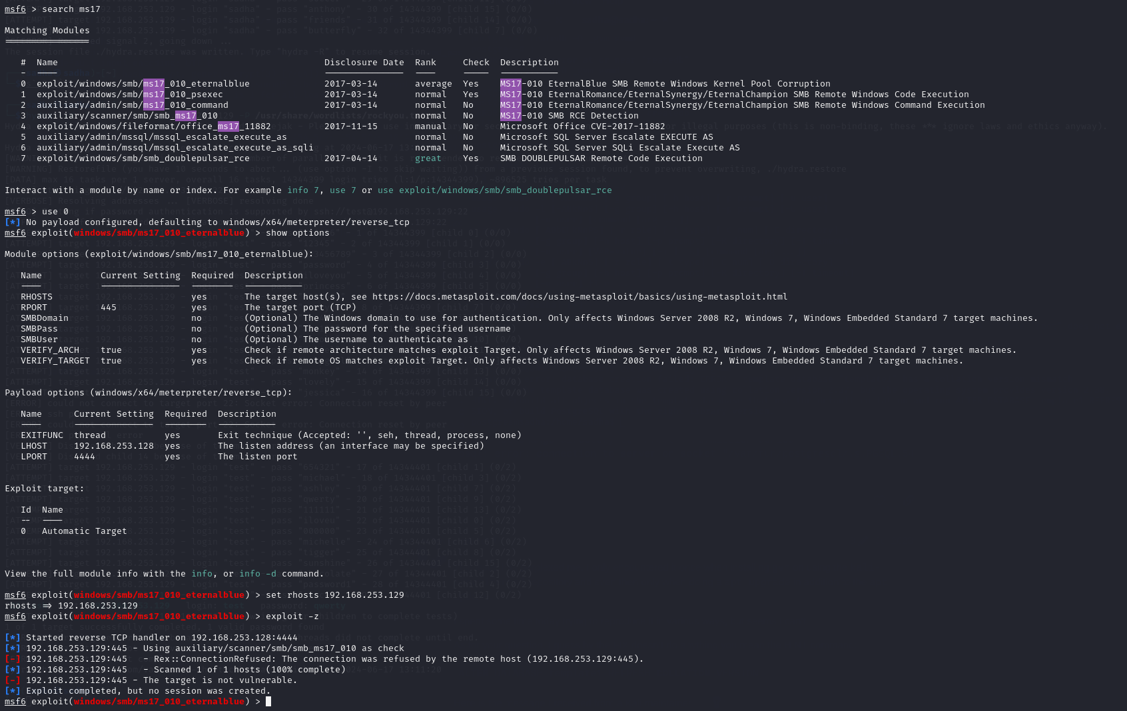
METASPLOIT FRAMEWORK

Slide 27
SQLMAP
SQLMap is a powerful and widely-used open-source tool designed to automate the process of detecting and exploiting SQL injection vulnerabilities in web applications. It supports a wide range of database management systems (DBMS) and offers numerous features to facilitate penetration testing and security assessments. Here’s an overview of SQLMap and its uses:
Key Features:
  Wide DBMS Support: Supports MySQL, Oracle, PostgreSQL, Microsoft SQL Server, SQLite, and many others.
  Automated Detection and Exploitation: Automatically detects and exploits SQL injection vulnerabilities.
  Database Fingerprinting: Identifies the DBMS and version.
  Data Retrieval: Extracts data from the database.
  Access and File System Operations: Provides capabilities to interact with the file system, execute commands, and escalate privileges.
  Advanced Techniques: Supports techniques such as time-based blind, error-based, UNION query-based, stacked queries, and more.

Slide 28
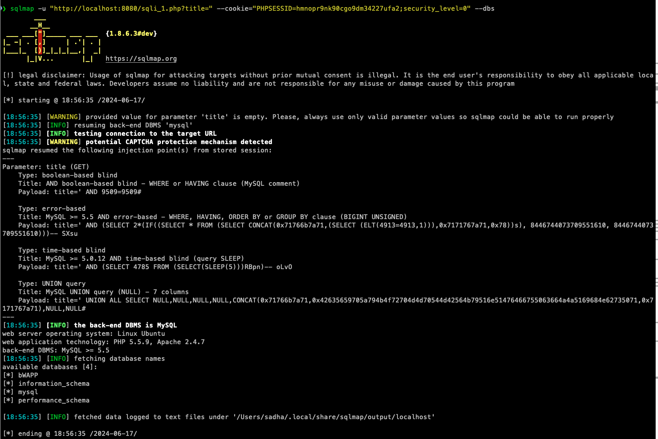
SQLMAP

Slide 29

John the Ripper
John the Ripper is a popular open-source password cracking tool used by security professionals and penetration testers to identify weak passwords. It supports various password hash types and offers multiple cracking modes, including dictionary attacks, brute-force attacks, and rainbow table attacks. Here’s an overview of John the Ripper and its usage:
Key Features:
  Multi-Platform Support: Available for Unix, Windows, DOS, BeOS, and OpenVMS.
  Multiple Cracking Modes: Dictionary attacks, brute-force attacks, and hybrid attacks.
  Extensive Hash Support: Supports a wide range of hash types, including DES, MD5, Blowfish, SHA-1, and many others.
  Customizable: Users can define custom cracking rules and extend the tool’s capabilities.
  Efficient: Optimized for performance and can leverage multi-core CPUs.

Slide 30
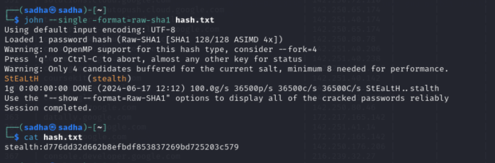
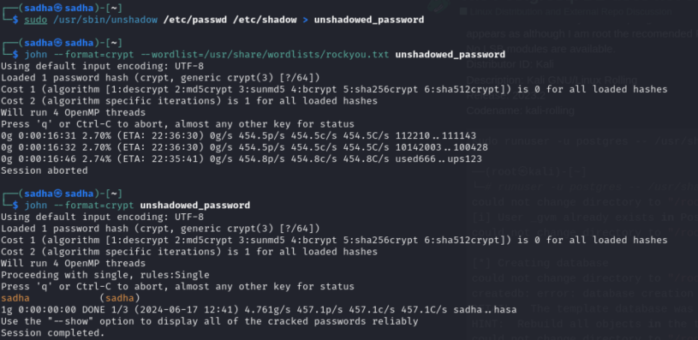
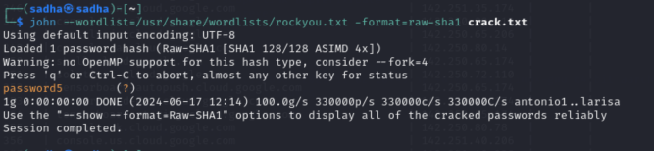
John the RIPPER

Slide 31
HYDRA
Hydra is a powerful and fast password-cracking tool used for brute-force attacks on various protocols and services. It is highly versatile, supporting numerous protocols, including HTTP, FTP, SSH, and more. Security professionals and penetration testers use Hydra to identify weak passwords and assess the security of authentication mechanisms.
Key Features:
  Multi-Protocol Support: Supports a wide range of protocols such as HTTP, FTP, SSH, Telnet, SMB, and many more.
  High Speed: Optimized for speed, allowing it to quickly test large numbers of credentials.
  Customizable: Supports various attack parameters and options to customize the brute-force attack.
  Parallel Attacks: Can perform multiple attacks in parallel, significantly speeding up the process.

Slide 32
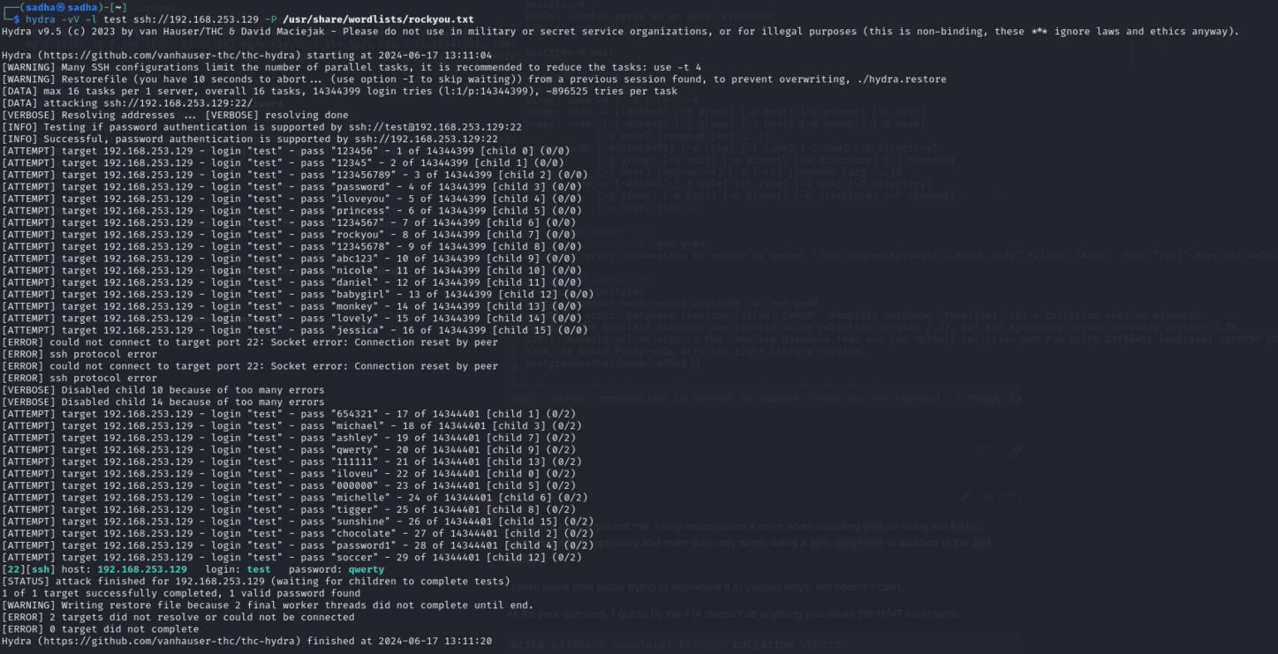
HYDRA

Slide 33
BURP suite
Burp Suite is a comprehensive set of tools for web application security testing. Developed by PortSwigger, it is widely used by security professionals and penetration testers to identify vulnerabilities and perform various web application security assessments. Burp Suite offers both automated and manual testing capabilities and includes features such as proxy, scanner, intruder, repeater, and more.
Key Features:
  Intercepting Proxy: Allows you to inspect and modify traffic between your browser and the target application.
  Scanner: An automated tool that identifies security vulnerabilities in web applications.
  Intruder: A powerful tool for automating customized attacks on web applications.
  Repeater: Allows you to manually modify and resend individual HTTP requests.
  Sequencer: Analyzes the quality of randomness in tokens.
  Decoder: Decodes and encodes data in various formats.
  Comparer: Compares responses to identify differences.
  Extensibility: Supports extensions through the Burp Extender API, enabling custom functionality.

Slide 34
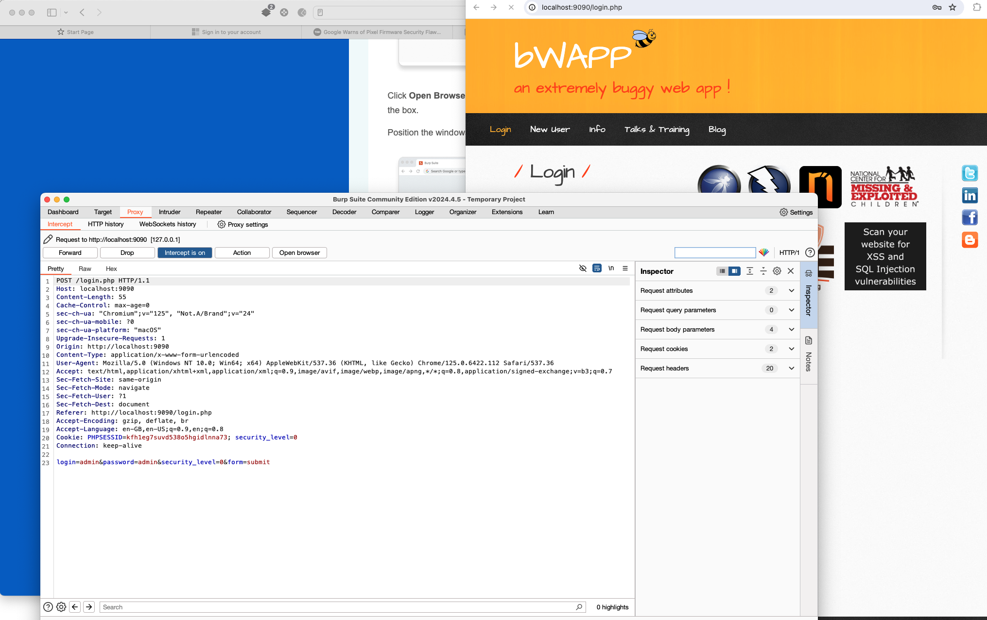
Burp SUITE

Slide 35
BONUS

Slide 36
Yersinia
Yersinia is a network security tool designed to take advantage of weaknesses in various network protocols. It supports attacks against several network protocols, including:
Spanning Tree Protocol (STP)
Cisco Discovery Protocol (CDP)
Dynamic Trunking Protocol (DTP)
Dynamic Host Configuration Protocol (DHCP)
Hot Standby Router Protocol (HSRP)
IEEE 802.1Q (VLAN)
IEEE 802.1X (Port-based Network Access Control)
Inter-Switch Link Protocol (ISL)
Link Layer Discovery Protocol (LLDP)

Slide 37
Yersinia
Yersinia operates by injecting crafted packets into the network to exploit vulnerabilities in network protocols. By doing so, it can perform various attacks such as:
Generating fake STP packets to become the root bridge in the network.
Sending spoofed DHCP responses to act as a rogue DHCP server.
Injecting fake CDP packets to confuse network management systems.
Exploiting DTP to negotiate a trunk link with a switch.
These attacks can disrupt network operations, lead to network misconfigurations, or allow the attacker to gain unauthorized access to network segments.

Slide 38
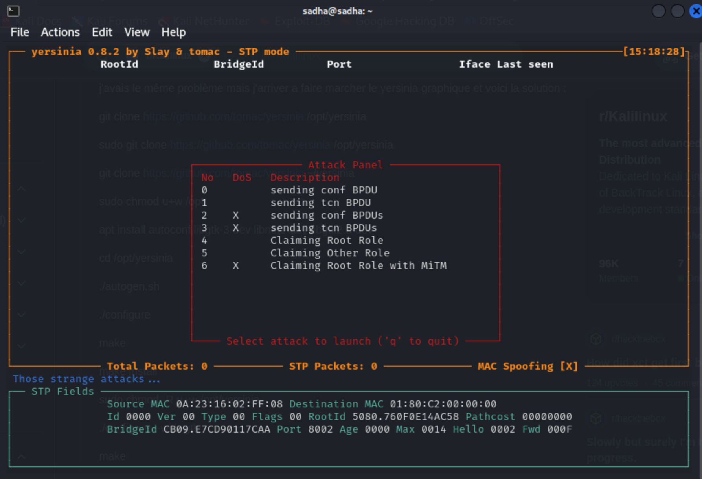
YersiniA

Slide 39

THANKS

